Slide 1
^{Ellesmere Tennis Academy}
^{Inspiring young tennis players}

Slide 2
Our goals
To encourage and inspire young tennis players to be the best they can be.
To nurture individual talent in a safe and supportive environment whilst enjoying a first class education amongst friends.
Develop pathways for a career in tennis as a player, a coach, in retail, leisure management or in the media/journalism.
Show players how to experience true fulfilment by inspiring a robust work ethic.

Slide 3
How to achieve our goals
Deliver a structured programme including: Individual coaching and group sessions, personal strength & conditioning plans, goal-setting and competitive match-play.
Acknowledge, promote and reward work ethic, self-motivation and team spirit.
Instil a disciplined and high quality approach to practice, training and match-play where players take responsibility for their own performance.

Slide 4
Talent Identification
Internal ID days; 2 per year all ages.
Open days.
Outreach Programme and External ID days.
Coach recommendations and overseas recruitment strategy.
Reputation, word of mouth.
Links to ‘The Shrewsbury Club’.

Slide 5
Academy structure
Recreational; Private coaching is available individually or in pairs to all students. Starter and Activity groups are available through the summer.
Development; Selected players form a more advanced training squad.
Performance; Selected players with the potential to play in College teams are placed in appropriate training squads and some Elite activities.
Elite; Squads for high rated players, competing regularly, strong county standard as a minimum.
Personal programme, goal setting and monitoring, strength and conditioning, nutritional guidance and sports psychology sessions.

Slide 6
Elite Player Commitment
Positivity; be a can do person, learn and improve.
Respect; work ethic, consideration, manners, honesty, attitude.
Individual responsibility; don’t blame others.
Diligence; be prepared and suitably equipped, practise purposefully.
Expectations; players and parents must set realistic goals.

Slide 7
Coaching staff
Stephen Welti; Director of Tennis.
LTA Registered Professional, BTCA Platinum
Jamie Donaghy; Elite Coaching Team.
LTA Level 4 CCA Performance Coach
Eifion Jones; Elite Coaching Team
LTA Level 4 Senior Performance Coach
Kyle Harvey; Elite Coaching Team
LTA Level 4 Senior Club Coach
Darren Ruff; Strength & Conditioning.

Slide 8
Facilities
4 Indoor Tennis Courts, High Performance Acrylic.
6 Outdoor Floodlit Tennis Courts, Hard.
9 Outdoor Artificial Grass Tennis Courts.
Sports Hall, 4 Mini Tennis Courts and Practice Wall.
Cardiovascular Fitness Suite.
Weight Training Room.

Slide 9
Competitions
Ellesmere hosts the following events annually:-
Over 50 LTA County Tour Grade 4 and 5 tournaments.
4+ LTA Regional Grade 3 tournaments.
LTA Inter County Cup events.
British Tour Fast Four tournament.
Play your way to Wimbledon.
LTA Schools Competitions, Aberdare Cup, Glanville Cup,
National Senior Students Boys and Girls events,
National Schools Year 7/8 and 9/10.
Primary Schools Mini Red Championships.
Internal Box Leagues.

Slide 10
How it works at Ellesmere
Ellesmere College; Academic/Pastoral
Academic timetable. Academy Facilities; courts, fitness, equipment.
Residential, Catering, Transportation, Marketing.
Director of Tennis; Academy Programme
Tennis timetable. Coaching programme management. 5 year plan.
Elite Programme management and recruitment.
Facility and Budget management.
Tournament and competitions programme.
Rally Together Ltd; Coaching Delivery
Provide coaching staff. Private Coaching delivery.

Slide 11
Preparing for the next step…
Links to American Universities, presentations to pupils and parents.
British University opportunities, presentations
Level 1 Coaching Award courses to Year 12 and 13 students.
Touring Player base; Students travelling the circuit have access to Ellesmere facilities after leaving the College.

Slide 12
Recent achievements
2024…..
2023 National ABERDARE CUP Girls Finalists (top 4 UK)
2023 National GLANVILLE CUP Boys Finalists.
2023 Regional LTA Senior Students Boys Champions
2023 Regional LTA Senior Students Girls Champions
2022/23 Regional LTA Schools Year 7/8 Boys & Girls Finalists
2022 National LTA Schools Year 9/10 Boys Finalists (top 4 UK)
2022 Regional LTA Senior Students Boys Champions
2021 National LTA Year 7/8 Boys Finalists (top 4 UK)
2020 National LTA Year 9/10 Boys Finalists (top 4 UK)
2019 National LTA Senior Students Boys Finalists
2018 National LTA Year 7/8 Girls Finalists (top 4 UK)
2017,16 &14 National GLANVILLE CUP Boys Finalists.

Slide 13
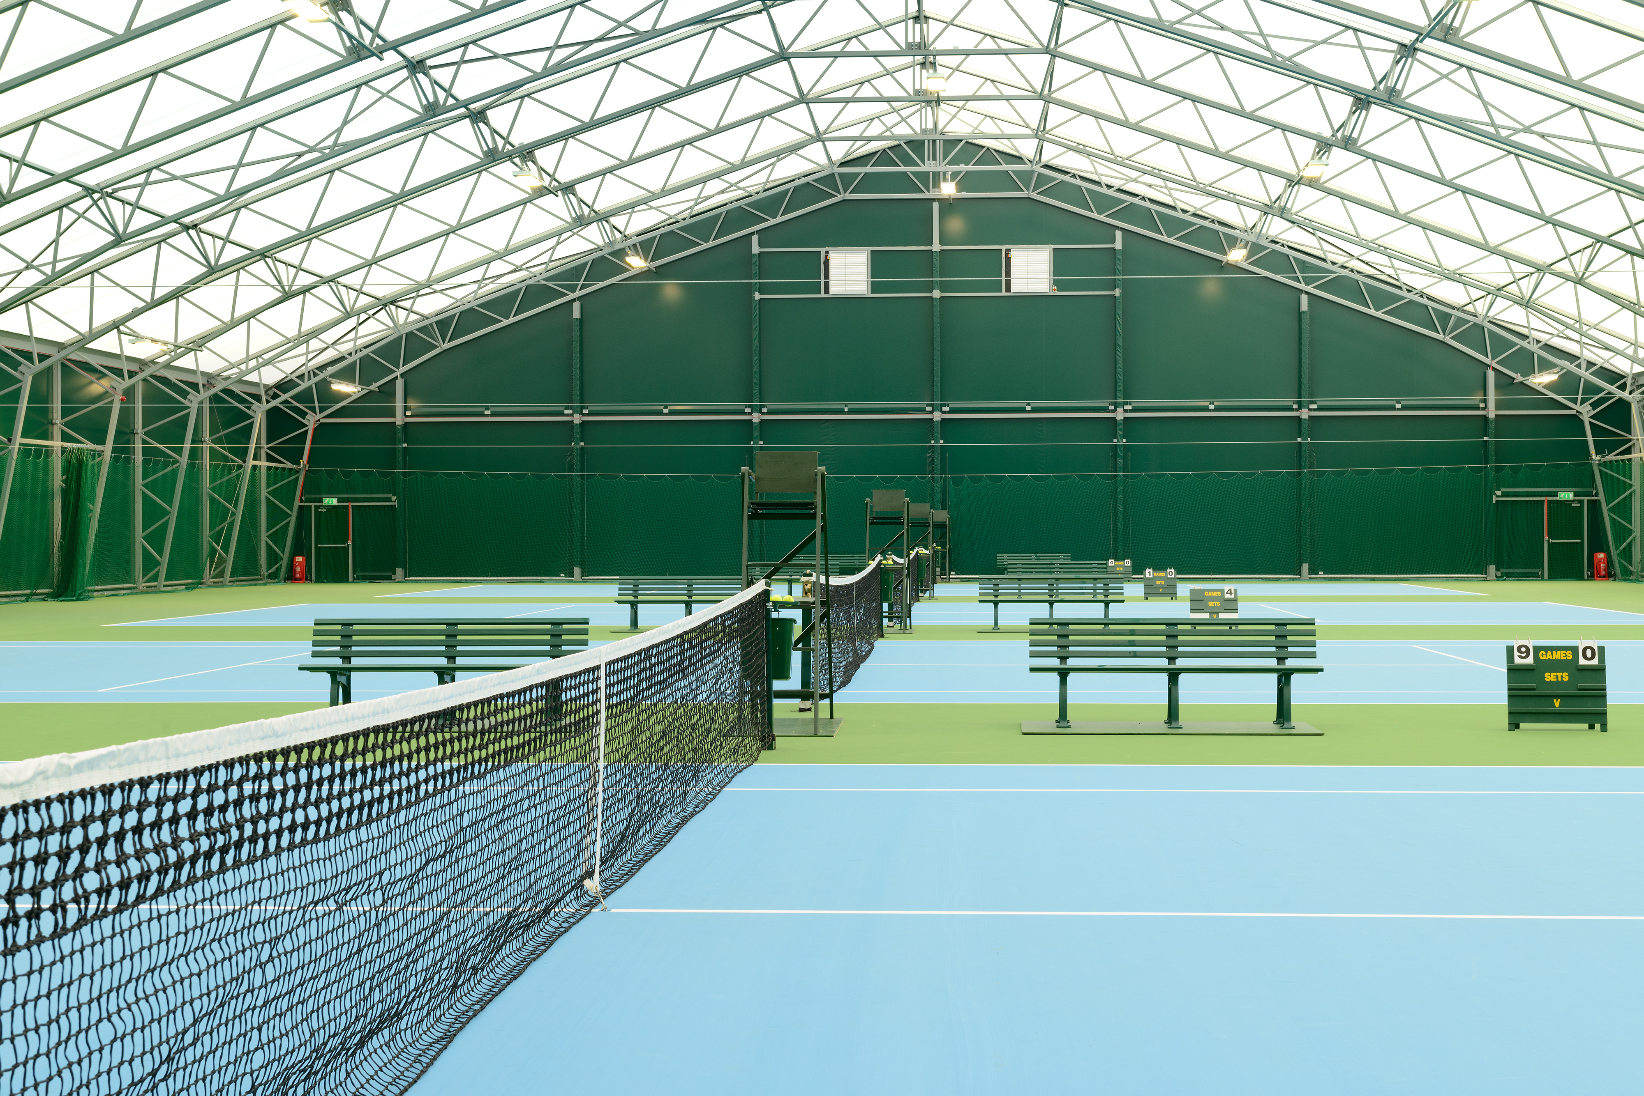
Find out more…..
From within the team the individual thrives.
stephen.welti@ellesmere.com

Slide 14
Proud to work with………
Head UK Tennis Smart
LTA Tennis Shropshire
The Shrewsbury Club OTT
Tennis Wales Rally Together

